Slide 1
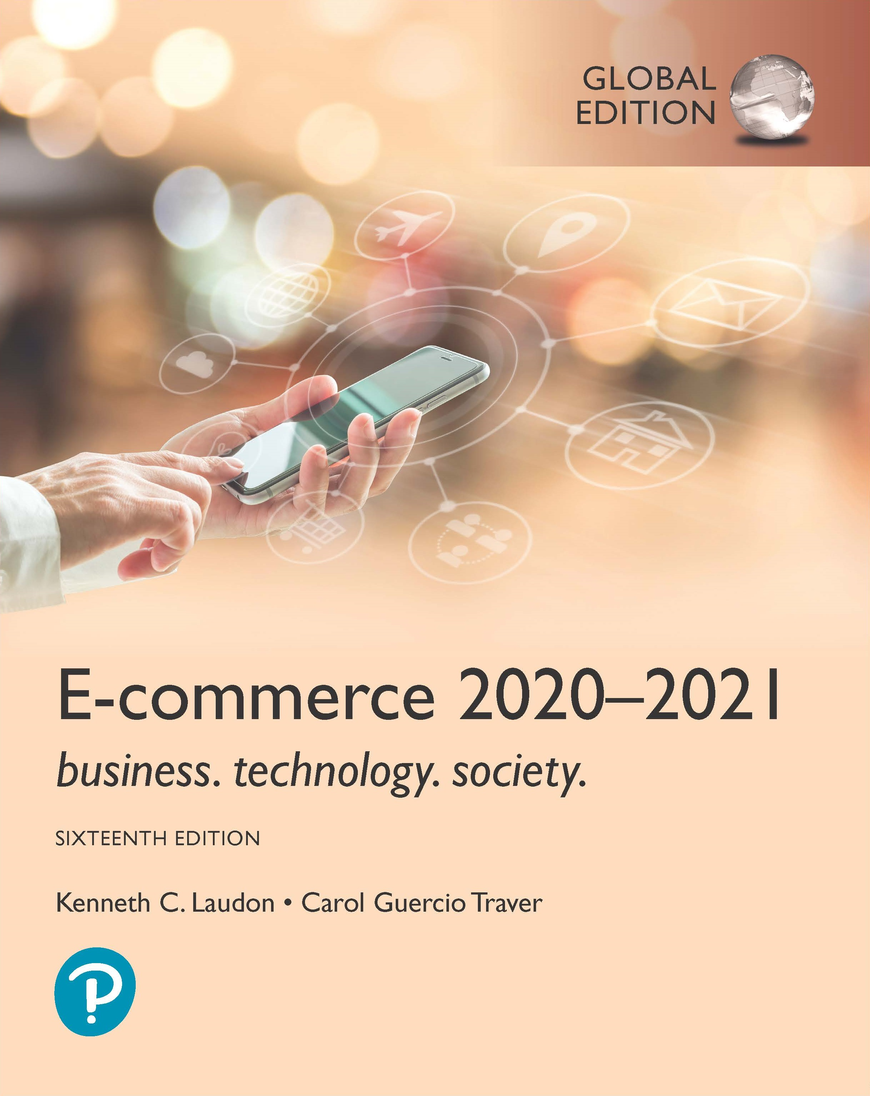
E-commerce 2020-2021: Business. Technology. Society.
Sixteenth Edition, Global Edition
Chapter 5
E-commerce Business Strategies
Copyright © 2021 Pearson Education Ltd. All Rights Reserved
Notes:
If this PowerPoint presentation contains mathematical equations, you may need to check that your computer has the following installed:
1) MathType Plugin
2) Math Player (free versions available)
3) NVDA Reader (free versions available)

Slide 2
Learning Objective
Critically discuss different E-Commerce Business models
E Commerce enablers
Identify the key components of e-commerce business models.
Notes:
Slide 2 is list of textbook LO numbers and statements

Slide 3
E-commerce Business Models
Business model
Set of planned activities designed to result in a profit in a marketplace
Business plan
Describes a firm’s business model
E-commerce business model
Uses/leverages unique qualities of Internet and Web

Slide 4
E-commerce Business Models Category
There are many e-commerce business models, and more and more are being invented every day.
The number of such models is limited only by the human imagination and list of models is certainly not exhaustive.
It is important to note that there is no one correct way to categorize these business models.
E-commerce business models would be incomplete without e-commerce enablers, which provide hardware, OS software, networks and communications technology, application software, web design, consulting services etc

Slide 5
E-commerce Enablers
E-COMMERCE ENABLERS
INFRASTRUCTURE | PLAYERS
Hardware: Web Servers | HP, Dell, Lenovo
Software: Web Server Software | Microsoft, IBM, Red Hat Linux (Apache) , Oracle
Cloud Providers | Amazon Web Services, Microsoft Azure, IBM Cloud, Google Cloud Platform
Hosting Services | Liquid Web, Weblntellects , 1&1, HostGator, Hostway
Domain Name Registration | GoDaddy, Network Solutions, Dotster
Content Delivery Networks | Akamai, Limelight Networks, Amazon CloudFront
Site Design | Weebly, Wix, Squarespace, Jimdo
Small/Medium Enterprise E-commerce | Shopify, BigCommerce YoKart Platforms
Enterprise E-commerce Platforms | Magento, IBM, Oracle, Salesforce, SAP, Intershop
M-commerce Hardware Platforms | Apple, Samsung, LG
M-commerce Software Platforms | Mobify, PredictSpring, Usablenet, GPShopper
Streaming, Rich Media, Online Video | Adobe, Apple, Webcollage
Security and Encryption | VeriSign, Check Point, GeoTrust, Entrust Datacard, Thawte, Intel Security
Payment Systems | PayPal, Authorize.net, Chase Paymentech, Cybersource
Web Performance Management | Compuware, SmartBear, Dynatrace
Comparison Engine Feeds/Marketplace Management | ChannelAdvisor, CommerceHub, CPC Strategy
Customer Relationship Management | Oracle, SAP, Salesforce, Microsoft Dynamics
Order Management | JDA Software, Jagged Peak, Monsoon
Fulfillment | JDA Software, Jagged Peak, CommerceHub
Social Marketing | Buffer, HootSuite, SocialFlow
Search Engine Marketing | iProspect, ChannelAdvisor, Merkle
E-mail Marketing | Constant Contact, Cheetah Digital, Bronto Software, MailChimp
Affiliate Marketing | CJ Affiliate, Rakuten LinkShare
Customer Reviews and Forums | Bazaarvoice, PowerReviews BizRate
Live Chat/CIick-to-Call | LivePerson, Bold360, Oracle
Web Analytics | Google Analytics, Adobe Analytics, IBM Digital Analytics, Webtrends

Slide 6
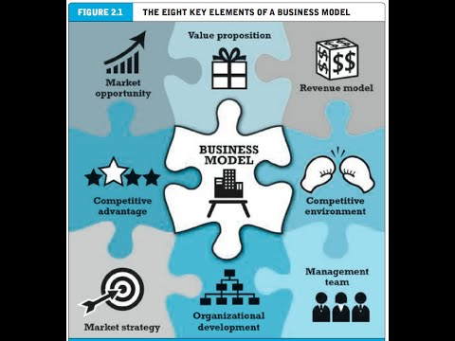
Eight Key Elements of a Business Model

Slide 7
Eight Key Elements of a Business Model
Value proposition
Revenue model
Market opportunity
Competitive environment
Competitive advantage
Market strategy
Organizational development
Management team

Slide 8
1. Value Proposition
“Why should the customer buy from you?”
Defines how a company’s product or service fulfils the needs of customers
Successful e-commerce value propositions:
Personalization/customization
Reduction of product search, price discovery costs
Facilitation of transactions by managing product delivery

Slide 9
2. Revenue Model
“How will you earn money?”
Major types of revenue models:
Advertising revenue model
Receives fees from advertisers.
Subscription revenue model
Freemium strategy
Transaction fee revenue model
Receives a fee for enabling of executing a transaction
Sales revenue model
Derives revenue by selling goods, information, or services
Affiliate revenue model
Steering business to an affiliate and receives a referral fees or percentage of the revenue from resulting sales.

Slide 10
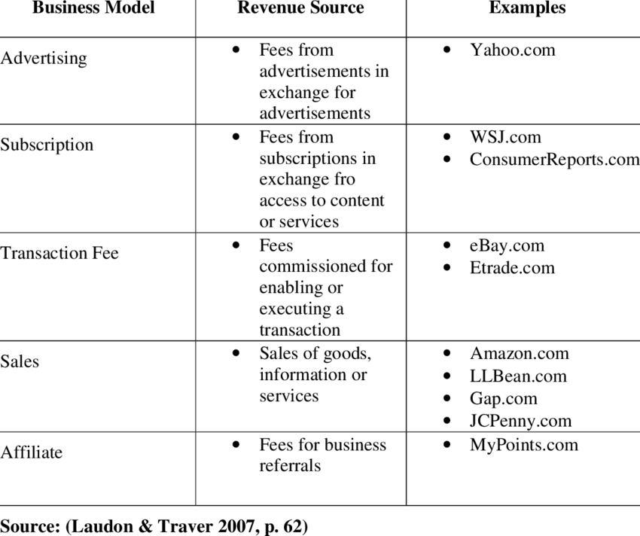
2. Revenue Model

Slide 11
Insight on Society: MADE.com: Furniture for the Crowd
Class discussion:
What revenue model does Made.com use? What other revenue models might be appropriate?
Are social media sources a reliable indication of current and future trends?
To what extent is Made.com not only a product, but also a solution to the needs of Millennials?

Slide 12
3. Market Opportunity
“What marketspace do you intend to serve and what is its size?”
Marketspace: Area of actual or potential commercial value in which company intends to operate
Realistic market opportunity: Defined by revenue potential in each market niche in which company hopes to compete
Market opportunity typically divided into smaller niches

Slide 13
4. Competitive Environment
“Who else occupies your intended marketspace?”
Other companies selling similar products in the same marketspace
Includes both direct and indirect competitors
Influenced by:
Number and size of active competitors
Each competitor’s market share
Competitors’ profitability
Competitors’ pricing

Slide 14
5. Competitive Advantage
“What special advantages does your firm bring to the marketspace?”
Is your product superior to or cheaper to produce than your competitors’?
Important concepts:
Asymmetries
Exists whenever one participant in a market has more resources than other participants.
First-mover advantage
A firm that results from being the first into a marketplace with a serviceable product or service
complementary resources (marketing, management, financial assets)
Unfair competitive advantage (brand name)
Leverage
When a company uses its competitive advantages to to achieve more advantage in surrounding markets
Perfect markets – all firms have equal access to all the factors of production

Slide 15
6. Market Strategy
“How do you plan to promote your products or services to attract your target audience?”
Details how a company intends to enter market and attract customers
Best business concepts will fail if not properly marketed to potential customers

Slide 16
7. Organizational Development
“What types of organizational structures within the firm are necessary to carry out the business plan?”
Describes how firm will organize work
Typically, divided into functional departments
As company grows, hiring moves from generalists to specialists

Slide 17
8. Management Team
“What kind of backgrounds should the company’s leaders have?”
A strong management team:
Can make the business model work
Can give credibility to outside investors
Has market-specific knowledge
Has experience in implementing business plans

Slide 18
Raising Capital
Seed capital,
an entrepreneur’s personal funds, derived from savings, credit card advances, home equity loans or from family and friends
Elevator pitch
Traditional sources
Incubators(accelerators) provide a small amount of funding and an array of services to start-up companies.
angel investors, wealthy individuals investing for an equity share in the stock of a business
Commercial banks, venture capital firms
Strategic partners
Crowdfunding - Kickstarter, Indiegogo
J O B S Act (Jumpstart Our Business Startups)
Notes:
Seed money, sometimes known as seed funding or seed capital, is a form of securities offering in which an investor invests capital in a startup company in exchange for an equity stake or convertible note stake in the company.
An elevator pitch is a brief, persuasive speech that you use to spark interest in what your organization does.
Well known incubators include INiTs(Austria), Accelarate (Denmark), Numa (France), and SeedRocket(Spain)
An angel investor is someone who invests their own money in a small business in exchange for a minority stake (usually between 10% and 25%). Angel investors tend to be entrepreneurs or people with extensive experience in the business world. However, angel investment is about more than just money.
Angel investors are rich persons who invest their own money in companies. Venture capitalists are employees of risk capital companies who invest other persons' money in companies.
The Jumpstart Our Business Startups Act, or JOBS Act, is a law intended to encourage funding of small businesses in the United States by easing many of the country's securities regulations. It passed with bipartisan support, and was signed into law by President Barack Obama on April 5, 2012
Crowdfunding involves using the Internet to enable individuals to collectively contribute money to support a project.
Top 10 crowdfunding websites:
Best Overall: Kickstarter
Runner Up: Indiegogo
Best for Creators: Patreon
Best for Shopify Stores: Crowdfunder
Best for Personal: GoFundMe
Best for Small Businesses: Fundable
Best for UK and Europe: Crowdcube
Best for Nonprofits: Mightycause
Best for Seed-Stage Companies: SeedInvest
Best for High-Growth Startups: StartEngine
Crowdfunding is becoming a mainstay in the development of movies, video games, art installation and man y other types of projects.
In UK, a 3-D game called Yooka-Laylee created by Playtonic games raised almost £2.1 million from over 73000 backers

Slide 19
Insight on Business: Crowdfunding Takes Off
Class Discussion
What types of projects and companies might be able to most successfully use crowdfunding?
Are there any negative aspects to crowdfunding?
What obstacles are presented in the use of crowdfunding as a method to fund startups?
Notes:
the practice of funding a project or venture by raising money from a large number of people who each contribute a relatively small amount, typically via the internet.
"musicians, filmmakers, and artists have successfully raised funds and fostered awareness through crowdfunding"

Slide 20
Categorizing E-commerce Business Models
No one correct way to categorize
Text categorizes according to:
E-commerce sector (e.g., B2B)
E-commerce technology (e.g., m-commerce)
Similar models appear in different sectors
Companies may use multiple business models (e.g., eBay, Amazon)
E-commerce enablers
Notes:
E-commerce enabler is a company that provides end-to-end solution for brands to do e-commerce business.
Those services include official store management, digital marketing, creative services, customer service management, supply chain management & fulfilment.

